Slide 1


Data visualization Track
Final Project Stock Market Analysis
Team
Shimaa Salah
Marwa Sabry
Mahmoud Mohamed
Khaled Magdy
Hassan Essam
Supervision by Eng.: Toaa Gamal

Slide 2



Introduction
What do you know about S&P 500??
S&P Global
Poor’s Publishing
(Guidebooks officially Founded 1868)
Standard Statistics Bureau(1906)

Slide 3

What is the S&P 500 and when it has started?
How are the companies chosen in S&P 500?
which is the best sector to invest in?
Which is The best company?
Comparison of year quarters to the end of Fiscal Year close price ?
Companies' performance over time
Which sectors losers and gainers in stock ?

Slide 4
Data Sources
1-https://en.wikipedia.org/wiki/List_of_S%26P_500_compans
2- https://www.kaggle.com/camnugent/sandp500
3-https://datahub.io/core/s-and-p-500-companies-financials#resource-constituents financials
Extra Data sources:
4-Gold price dataset (Kaggle)
5-Crude oil price dataset (Kaggle)
6-Inflation , Interest , Unemployment rate (Kaggle)
7-Industry classification dataset (Wikepedia)
8-S&P 500 on August 2018 (Wikepedia)
9-S&P 500 daily data on 2020 (Kaggle)

Slide 5
Data warehouse Modeling
Schema Used :
GALAXY SCHEMA – as the business has more than one business processes.
Business Process:
Stock market analysis, analyze companies' status on S&P 500
Grantuality: Atomic per day

Slide 6
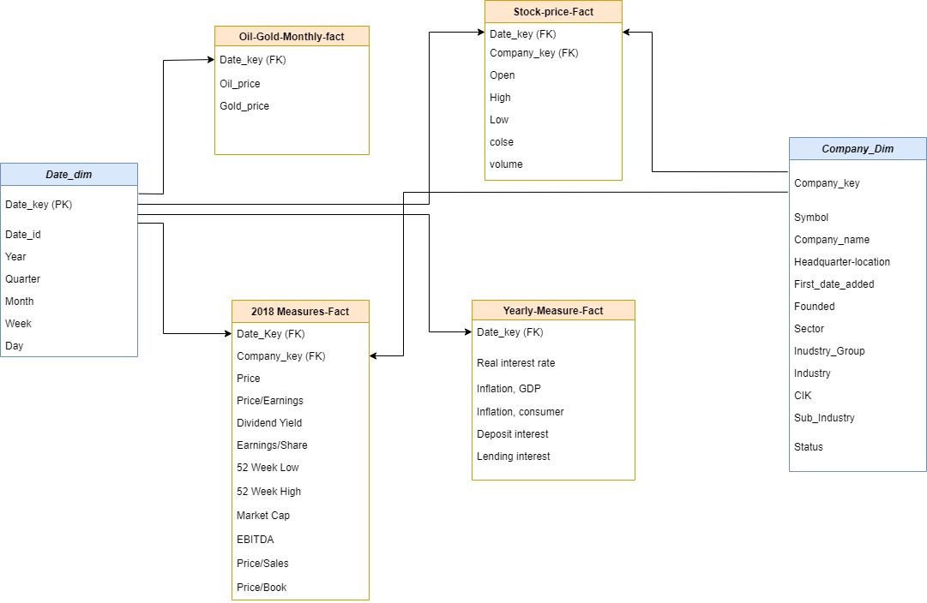
Logical Model

Slide 7



TOOL USED
Import Data using SQL Developer
Data Preparation using Excel
Visualization using power BI

Slide 8
Conclusion
The investor must consider the history of the stock over time in details
and the different types of indicators
This will approximately grant the earnings or at least minimizes the losses
because of the high rate of variations in that type of market !

Slide 9
Introduction
What do you know about S&P 500??
S&P Global
Poor’s Publishing
(Guidebooks officially Founded 1868)
Standard Statistics Bureau(1906)

